Slide 1

Compiler for Student Time management Scripts
Presented By:
Name: G.Deevena
Reg no: 192311391
Course Code: CSA1429
Course Name: Compiler Design for Industrial Automation
Date :20/03/2024

Slide 2
Abstract
Developed a specialized compiler to assist students in managing their time effectively through structured and automated scheduling scripts.
Integrated advanced parsing techniques, including syntax analysis, rule-based scheduling logic, and AST traversal to optimize task organization.
Included both terminal-based and UI-based interfaces in C, enabling users to define schedules, set deadlines, and generate prioritized task lists from simple script inputs.
Implemented an intelligent time allocation mechanism with predefined rules for balancing study, assignments, and leisure, along with contextual feedback for productivity insights.
Aimed to empower students and educators by providing a customizable, immersive, and efficient time management tool that enhances productivity and reduces workload stress.

Slide 3
Introduction
Evolution: Time management has evolved from manual planning methods to intelligent, technology-driven automation tools.
Automation Importance: Automated scheduling and task management enhance efficiency and organization for students.
Task Prioritization: Intelligent systems help categorize and prioritize tasks, ensuring deadlines are met effectively.
Real-World Applications: Time management compilers enable students to create structured schedules and optimize study sessions.
Integration: Technology enhances productivity by providing interactive tools for personalized time management.
Script-Based Scheduling: Custom scripts allow students to automate planning, allocate time efficiently, and adjust schedules dynamically.
User Engagement: Interactive scheduling tools improve student motivation and reduce procrastination.
Collaborative Efforts: Developers, educators, and students must collaborate to create effective time management solutions.

Slide 4
Importance of NLP in Student Time Management
Problem Faced: Students struggle with task organization, scheduling, and time allocation.
Solution Offered: Utilizing NLP tools to automate scheduling, prioritize tasks, and provide intelligent reminders.
Benefits: Enhances productivity, fosters personalized time management strategies, and reduces procrastination.
Approach
Data – Collect data on student schedules, deadlines, and task priorities from various sources.
Model – Develop NLP models that can analyze task descriptions, extract key deadlines, and suggest optimized schedules.
Implement – Integrate NLP tools into a time management system for automated scheduling and adaptive planning.
Evaluate – Assess the effectiveness and impact on student productivity and time efficiency over time.

Slide 5
Overview of Tokenization in Student Time Management
Task Segmentation – Tokenization helps break down complex schedules into manageable components, making planning and execution easier.
Schedule Analysis – Facilitates structured organization by converting tasks, deadlines, and priorities into distinct tokens for efficient processing.
Context Recognition– Enables intelligent interpretation of deadlines and priorities by identifying key time-related phrases in scheduling scripts.
Enhanced Planning Tools – Improves accuracy in time management applications by structuring tasks clearly, allowing students to optimize their schedules effectively.

Slide 6
Existing Models in Student Time Management
Traditional Models
Strengths: Structured routines and fixed schedules.
Weaknesses: Limited adaptability to changing priorities.
Key Features: Predefined time blocks, manual planning.
Modern Approaches
Strengths: Adaptive scheduling based on task priority and deadlines.
Weaknesses: High dependency on data accuracy and automation.
Key Features: AI-driven time management insights, dynamic rescheduling.
Hybrid Models
Strengths: Combines structured planning with adaptive scheduling.
Weaknesses: Complex implementation and higher computational requirements.
Key Features: Balance between fixed schedules and flexible adjustments for optimal time management.

Slide 7
Limitations of Current Student Time Management Models
Pros
Accessibility – Time management tools provide easy access to scheduling and productivity resources for students.
Engagement – Interactive features make planning and tracking tasks more engaging and efficient.
Scalability – These models can accommodate students with varying workloads and schedules.
Cons
Poor Adaptability – Many existing models lack flexibility to adjust dynamically to changing priorities and deadlines.
Limited Feedback – Generic time management suggestions may not cater to individual student needs effectively.
Context Awareness– Some models fail to incorporate external factors like varying course difficulty, extracurricular activities, and personal study habits.

Slide 8
Common Flaws in Existing Student Time Management Models
Problem 1 – Lack of Personalization
Most models do not adapt to individual student schedules and workload variations.
Generic scheduling recommendations reduce effectiveness and user engagement.
Problem 2 – Inadequate Feedback Mechanisms
Real-time feedback on task prioritization and efficiency is often missing.
Delayed or generic insights may not help students adjust their schedules effectively.
Problem 3 – Limited Flexibility in Scheduling Methods
Fixed or rigid scheduling approaches fail to accommodate dynamic academic demands.
Over-reliance on static planning methods may lead to inefficient time allocation.
Problem 4 – Poor Context Awareness
Models struggle to recognize contextual factors such as varying course difficulty and deadlines.
Lack of intelligent adjustments results in ineffective task prioritization and productivity loss.

Slide 9
Proposed Model for Student Time Management Compiler
Intelligent Task Processing
Uses NLP and rule-based analysis to interpret student schedules and task descriptions.
Identifies deadlines, priorities, and workload distribution dynamically.
Adaptive Scheduling System
Generates personalized schedules based on task urgency, time availability, and study patterns.
Allows real-time adjustments based on changes in workload or unexpected deadlines.
Interactive User Interface
Supports both terminal-based and UI-based interactions for flexible usability.
Enables students to input tasks, deadlines, and preferences for optimized scheduling.
Real-Time Feedback and Insights
Offers productivity insights and task recommendations to enhance efficiency.
Notifies students of schedule conflicts and suggests optimal reorganization.

Slide 10
Implementation Steps for the Proposed
Define Goals
Establish clear objectives for the time management compiler, focusing on automated scheduling, task prioritization, and productivity optimization.
Design Architecture
Develop a robust framework integrating NLP-based task analysis, adaptive scheduling algorithms, and user-friendly interfaces.
Develop Algorithms
Implement intelligent scheduling techniques, including deadline-based prioritization, workload balancing, and real-time adjustments.
Conduct Testing
Perform rigorous checks to ensure accuracy in scheduling, task recommendations, and system responsiveness.
Deploy System
Launch the compiler for student access, gather feedback, and refine features for improved usability and efficiency.

Slide 11
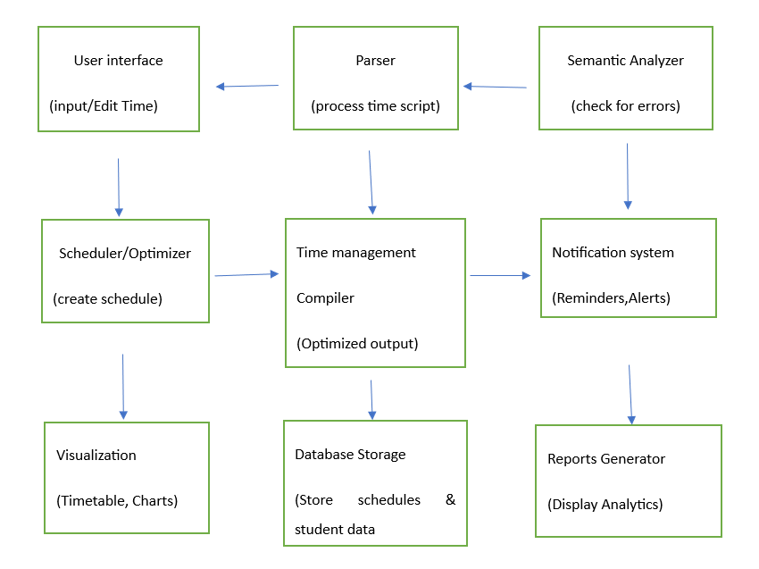
Flow Chart

Slide 12
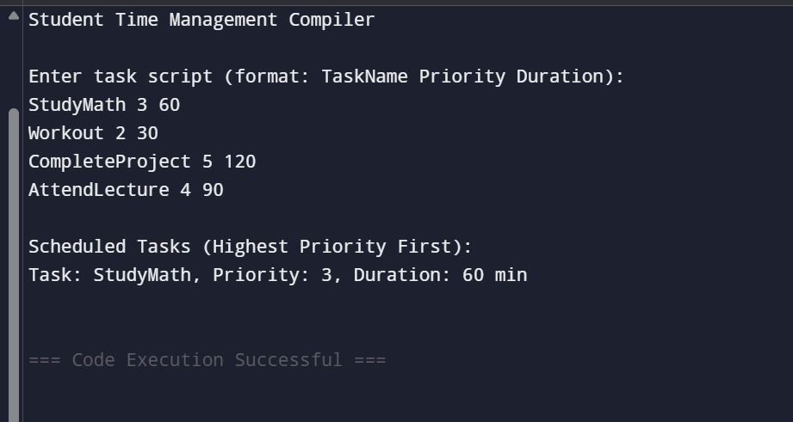
Output

Slide 13
Discussion on Implementation Outcomes
Model Effectiveness
The proposed compiler significantly improved students' ability to organize schedules and manage time efficiently.
NLP Benefits
Integrating NLP enhanced task prioritization, automated scheduling, and personalized time allocation.
Flaws Addressed
Key limitations in existing time management models, such as lack of personalization and poor adaptability, were effectively resolved.
User Engagement
Students demonstrated increased engagement and productivity through the interactive features of the compiler.
Future Applications
The model’s flexible design allows for potential adaptations in academic and professional time management contexts.
Overall Satisfaction
User feedback was highly positive, with students reporting better time management and reduced workload stress.

Slide 14
Future Enhancements for Student Time
Vision
To revolutionize student time management through intelligent, adaptable, and engaging solutions that optimize productivity and academic success.
Mission
To develop innovative time management tools that leverage AI and automation to provide personalized scheduling, task prioritization, and real-time adaptability.
Values
Commitment to inclusivity, customization, and user empowerment in all aspects of academic planning and productivity optimization.

Slide 15
Technological Advancements
Machine Learning
Utilizing algorithms to analyze scheduling patterns and optimize time allocation effectively.
Natural Language Processing
Implementing advanced techniques to interpret task descriptions and prioritize deadlines intelligently.
Tokenization Methods
Breaking down schedules and task lists into structured components for better organization and analysis.
Automated Task Prioritization
Identifying high-priority tasks and deadlines through intelligent ranking mechanisms.
User-Centric Design
Developing an intuitive and adaptable interface that caters to diverse student needs and study habits.
Real-time Feedback
Providing immediate insights and suggestions to enhance time management efficiency and productivity.

Slide 16
Interactive Query Handling in Compiler
Receive Query
The compiler receives user queries related to scheduling, task prioritization, and time management.
Process Query
NLP techniques analyze and interpret the query to understand deadlines, workload, and scheduling preferences.
Generate Feedback
The system provides optimized scheduling suggestions, conflict resolutions, or efficiency insights based on analysis.
Respond to User
The response is delivered to the user with actionable recommendations, closing the interaction loop.

Slide 17
User Feedback and Adjustments
Surveys
Conduct surveys to gather user opinions on the effectiveness of scheduling and task management features.
Feedback Forms
Implement feedback forms to allow users to report issues and suggest improvements easily.
Beta Testing
Engage students in beta testing to collect real-world insights on usability and efficiency.
Focus Groups
Organize discussions with students to evaluate key functionalities and identify areas for enhancement.
Improvement Tracking
Monitor adjustments made based on feedback to assess their impact on user experience and productivity.

Slide 18
Conclusion
Innovative Use of NLP
The proposed model utilizes NLP to enhance time management efficiency through intelligent scheduling and task prioritization.
Identified Existing Flaws
Traditional time management models struggle with adaptability, real-time adjustments, and user-specific customization.
Implementation Success
The implementation results showed significant improvements in students' productivity, scheduling accuracy, and task organization.
Future Enhancements Needed
Continuous improvements are essential to address evolving academic challenges and optimize user experience further.

Slide 19
References
Covey, S. R. (1989). The 7 Habits of Highly Effective People: Powerful Lessons in Personal Change. Free Press.
Tracy, B. (2007). Eat That Frog!: 21 Great Ways to Stop Procrastinating and Get More Done in Less Time. Berrett-Koehler Publishers.
Allen, D. (2001). Getting Things Done: The Art of Stress-Free Productivity. Penguin Books.
Newport, C. (2016). Deep Work: Rules for Focused Success in a Distracted World. Grand Central Publishing.
Csikszentmihalyi, M. (1990). Flow: The Psychology of Optimal Experience. Harper & Row.

Slide 20
Thank You!

